Slide 1
CSE 676 – DEEP LEARNING Music genre detection
By –
Arnav Sinha | UBID : 50419372
Rahul Rammohan Mandical | UBID : 50363222

Slide 2
Code Repo Information
The code for the project has been organized as a Github repository.
It can be accessed from the following link - https://github.com/arnavsinha109/Music-Genre-Detection
All the notebook have been organized as individual RISE slides for reading comfort

Slide 3
Table of Contents
Introduction
Literature Survey
Literature Deep Dive – Paper 6
Dataset Selection Process
Dataset Pre-Processing
Phase 1 – Metadata Extraction
Phase 2.1 – Audio Features Extraction
Phase 2.2 – Theme Features Extraction
Phase 3 – Final Dataset Creation
Models
Part 0 – Precursor Experiments
Part 1 – K Nearest Neighbors
Part 2 – Deep Neural Networks
Models
Part 3 – Convolutional Neural Network
Part 4 – Recurrent Neural Networks – Long Short-Term Memory
Part 5 – Recurrent Neural Networks – Gated Recurrent Units
Part 6 - Hybrid Models (CNN + RNN)
Part 7 – 125 Vec Dataset Models
Experiment Results
Conclusion
References

Slide 4
introduction

Slide 5

Aim
The main aim of this project is to efficiently and accurately predict the primary genre of the music by using both audio and lyrical (theme) data.
Genre here refers to a conventional category that identifies some pieces of music as belonging to a shared tradition or set of conventions.
Example : Rock, Hip-hop, Electronic etc.
We will use Deep Learning Algorithms to predict the genre of the music by training them on audio(MFCC) data and lyrical (theme) data

Slide 6
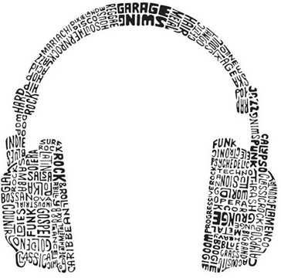
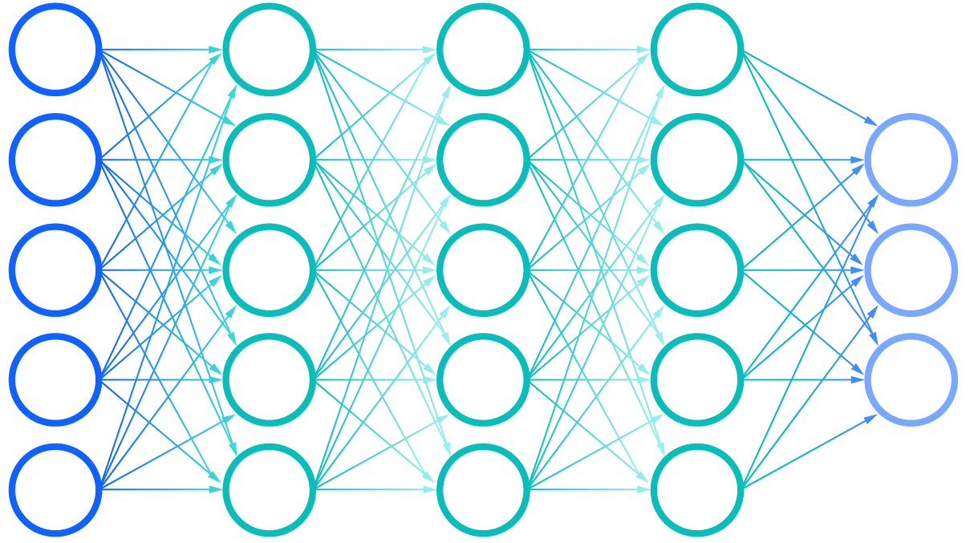
Objectives
Primary Objective
The primary objective is to build Deep learning models which can accurately predict the main genre of the music. This is achieved by usage of Deep, Convolutional and Recurrent neural networks.
Secondary Objectives
Experiment the effect of lyrical data has on the Neural Network models. This is tested by comparing models which used both audio and lyrical data versus models which used only audio data.
Identify if it is better to have longer songs but less in number or have shorter songs which is more in number i.e. 250 vector size vs 125 vector size. This is verified by splitting each audio into 5 vs 10 parts and training the networks.

Slide 7
Why even identify the genre?
There are many advantages in knowing the genre of song
Academic use - Understanding different types of genres and its characteristics can not only help us write more music but also recognize the hidden mysteries that makes a song special
Commercial use – Big music corporations such as Spotify or Soundcloud can better tag and segregate huge amounts of songs without the need of human intervention and thus enable better music information retrieval practices.
The biggest advantage we get by using DL algorithms is that these models can identify and learn the intricacies that helps identify the song to its genre in the most efficient way

Slide 8
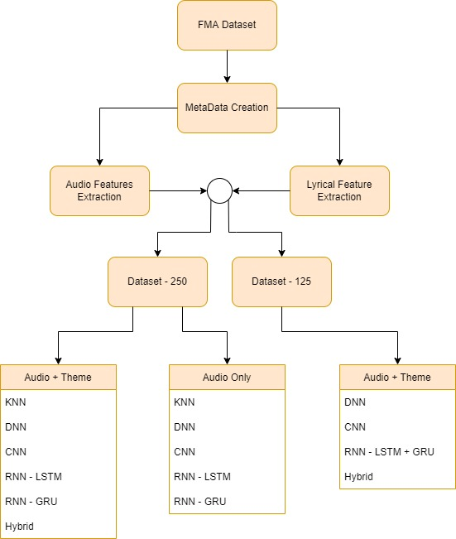
Summary of our Project - Preprocessing
The main dataset contains 25000 songs which are obtained from Free Music Archive (FMA) repo. It also provided us with metadata for these songs
For the audio files, each file gets divided into 5 or 10 parts and their Mel-frequency cepstral coefficients (MFCC) are extracted. For lyrics, we use an API to download the lyrics and using CBOW dictionary, we convert the text into word embeddings and get the theme
Based on the MFCC features, we can obtain a vector size of 250 and 125. We will consider 250 vec dataset as our main dataset since we assume that having more data per song is more important.

Slide 9
Summary of our Project – Model Building
For the 250 Vec Dataset, we build models using the following algorithms. K nearest neighbor, Deep neural network, Convolutional neural network, Recurrent neural network – GRU and LSTM.
Each algorithm is used to train two types of models, one type of models uses both lyrical and audio data while the other uses only audio data.
After training the 250 vec Dataset models, we take the best models and train them on 125 vec dataset.
Compare the best models for Audio + Lyric features vs Audio features only.
Compare the best models for 250 vec vs 125 vec

Slide 10
Literature survey

Slide 11
Techniques used in Related Work
This is not a new problem and all the papers that we surveyed have used similar techniques to tackle with their own flavor
The related work can be broadly classified into three categories
Papers that work on audio data primarily
Papers that work on lyrical data only
Papers that use composite data i.e., combination of audio and lyrics along with other supplementary features
Our attempt lies in the third category

Slide 12
Audio features centric papers
This category had the greatest number of papers which makes sense since audio itself is the most important resource for identifying its genre.
Most of the papers use a spectrograph or its variants. Some of them also use MFCC and its alternatives. Multiple types of Deep learning algorithms have been used along with some unique architectures
Liu et al. uses a novel CNN architecture that takes into consideration the long contextual information. The paper uses Mel spectrogram to represent the audio. They experimented on multiple datasets including GTZAN and produced a respectable results of 93.9% accuracy.

Slide 13
Audio features centric papers
Like Liu et al. , Dong et al. and Zhang et al. also use CNN as their main algorithm. Dong et al. uses an ensemble approach where the genre is predicted by splitting the audio and the combining the results of the model for all the parts. They also claim to outperform human predictions. Zhang et al. on the other hand takes a more common approach and produces two models one using pooling and other using shortcut connections similar to residual learning. Zhang et al. also trains its models on GTZAN dataset
Feng et al. uses an STFT spectrogram to represent the audio and creates a model that is a combination of CNN and RNN (B-GRU). They produce similar results to our models but on GTZAN dataset

Slide 14
Audio features centric papers
Hsu et al. takes a different approach and tries to classify the sub genres of EDM music. They use Mel-Spectrogram and Tempogram Features. They use a unique short chunk CNN + ResNet models.
Heo et al. uses frequency sub bands aggregation method which divides the input spectrogram along frequency bandwidths. Their framework is based on ECAPA - TDNN, where all the layers that extract short-term features are affected by the layers that extract long-term features. They train their models on much larger dataset, but the results leave a lot to be desired for.

Slide 15
Audio features centric papers
While all the papers use a balanced dataset, Liu, Xiaokai et al. proposed a novel mechanism named Multi-instance Attention (MATT) which is used to boost performance for tail classes. This helps target imbalanced datasets where certain genres do not have enough audio files
Chathuranga et al. doubles down on using ML algorithms for their models. They work on GTZAN and ISMIR2004 by using SVM Classifier with polynomial kernel functions. The weak learner is compensated by using Adaboost and Ensemble classifiers. The models have provided a surprising accuracy of 78 % and 81% for the datasets used

Slide 16
Audio features centric papers
KarunaKaran et al. uses a two-phase hybrid classifier to overcome the blurry classification of the genres. Similar to our paper they have worked on GTZAN and FMA dataset. Our models have outperformed their models for FMA dataset.
Most of these papers have used GTZAN as their main dataset. In our opinion the biggest drawback of this dataset is its smaller size. Further reasons as to why we did not use this dataset will be established later

Slide 17
Lyrics features centric papers
This is a niche category for our problem, fewer papers chose to solve the problem using only lyrics
Tsaptsinos et al. uses a Hierarchical Attention Network on the lyrics to exploit the layer structures in which words combine to form lines, lines form segments, and segments form a complete song. They tested the models on both 117 genre Dataset and 20 genre dataset. They were also able to visualize which words are most important
Araujo Lima et al used BLSTM along with SVM and Random forest combined with multiple word embeddings techniques. However, these models were built to identify Brazilian lyrics specifically

Slide 18
Composite features centric papers
Instead of concentrating on only one aspect, these papers have created models to encompass both audio and lyric features.
Oramas et al. takes a distinctive approach where they use cover image, text reviews and audio tracks. They also present their MuMu dataset which contains over 31k albums with 250 genres. The paper provides a different perspective to classification by using different Data modalities
McKay et al takes a step further by considering cultural features such as web searches along with the usual features. They also showed how features extracted from lyrics were less effective compared to others.

Slide 19
Composite features centric papers
Finally, we have Mayer et al. which tends to lean more heavily towards lyrics. They use advanced lyrics features such as the frequency of certain rhyme patterns, several parts-of-speech features, and statistic features such as words per minute (WPM) along with regular audio features. This paper sticks to ML models using KNN, Naïve Bayes and SVM. The results range from 40 to 60% for various datasets which clearly shows the short comings of ML models

Slide 20
Literature Deep Dive
Lyrics-Based Music Genre Classification Using a Hierarchical Attention Network

Slide 21
Brief Summary
While the literature survey section briefly talks about many papers. This paper in particular caught our attention. It takes a complete NLP approach to solve the issue of genre detection.
The paper uses only Lyrical data similar to how we have used except the preparation and pre-processing are quite different.
Some of the biggest contribution from this paper is that HAN or Hierarchical Attention Networks can be used to take advantage of the hierarchical structure of the sentences and we can clearly visualize which words are most important. We believe that knowing what words are most important to define genre greatly benefits the models.

Slide 22
Datasets Used and Word Embeddings
The paper uses a very huge Lyrical Dataset acquired from LyricFind which contained around 1,039,151 songs. While there were no genres, the author was able to acquire them with the help of iTunes. This however severely reduced the number of songs due to lack of missing data.
Instead of simply creating their own dictionary, the author has retrained their words over the GloVe embeddings which they claim helps boost the metrics.
They create two datasets one with 20 genres and other with 117 genres.

Slide 23
Hierarchical Attention Networks
The main algorithm used is Hierarchical Attention Networks. It is based on bidirectional gated recurrent unit with attention applied to its output.
We humans understand the meaning of sentence by reading the words and understand the paragraph by understanding the group of sentences. Similarly, the network tries to understand the context of the word with respect to its placement along with its inherent meaning. This is especially helpful for Homonyms.
The BRNN part learns the meaning behind those sequences of words and returns a vector. The attention network gets the weights for each vector using its own shallow neural network. Then it aggregates the representation of those words to form a sentence vector. This weighted sum embodies the whole sentence.
Similarly, they also do the same to sequences of sentences to understand the paragraph.

Slide 24
Experiments and results
The paper compares HAN with other algorithms such as Logistic Regression and LSTM.
While the overall performance of all models are in the range of 40 –50%, we see that HAL as outperformed the other algorithms in both 20-genre dataset and 117-genre dataset.
The metrics show that while the models are good, perhaps lyrics are just not enough for classification of genres. The best way to improve the models in our opinion is to introduce extra features in the form of audio representation of external cultural features.

Slide 25
Attention Visualization
According to us, The most important takeaway from this paper is the Attention visualization. By observing the weights for the words, we can extract what kind of words have the most impact to the genre.
The author mentions that words such as 'cause' and 'gonna' were mostly weighted in hip hop songs and 'your' and 'you' in rock songs along with 'woh' and 'ooh'.
This feels in line with the current trend in music. However, the model is not perfect as it has weighed heavily on empty space. This could either be the importance of silence and an issue in dataset.

Slide 26
Take-Aways
This paper solves one of our sub-problems about how to extract the most important part of Lyrics. We use a theme approach, but this HAN approach makes sense too.
Perhaps in the future, we can substitute our theme part with a HAN model to give us the most important words from each song. This can be extracted from the weights of the attention network.
The idea of retraining GloVe word embeddings is also something we could have experimented on in our project.

Slide 27
Dataset selection process

Slide 28
Which dataset is the right one – GTZAN, Spotify or FMA?
GTZAN Dataset
Also known as ‘gtzan8’, it consists of 1000 tracks of 30 seconds each representing 10 genres of 100 songs each
The dataset is used as a benchmark dataset in ML and was used in the very popular paper “Musical genre classification of audio signals” by G. Tzanetakis and P. Cook
Spotify Dataset
It involves creating our own dataset using the Spotipy (Python library for Spotify Web API) rather than utilizing an existing dataset
FMA Dataset
Also know as ‘Free Music Archive’ dataset consists of 100k plus 30 second songs
It was introduced in the paper ‘FMA: A Dataset for Music Analysis’ by Michaël Defferrard et al in 2016 and aims to provide a huge audio dataset with granular metadata for music information retrieval tasks

Slide 29
GTZAN
The dataset is very popular and has the added benefit of providing a balanced classes for genre detection problems for 10 genres
Challenge –
It does not provide metadata necessary for the purpose of building a lyrics dataset for the songs included in the dataset
The dataset is small to build robust neural networks
Conclusion –
We chose to drop this dataset for our project

Slide 30
Spotify Web API Dataset
After dropping GTZAN, we looked at using the Spotify Web API to create our own dataset
This would also give us access to all of the music data available on the Spotify platform including metadata necessary for creating an equivalent lyrics dataset
Challenge –
It added the complexity of working around licensing issues prevalent in the music industry
Additionally, extracting MFCC features was not possible due to bad data
Conclusion –
We chose to drop this dataset

Slide 31
Free Music Archive (FMA) Dataset
We finally decided to explore the FMA dataset which had a total of 106k songs along with their relevant metadata
It was configured in three sets – FMA Small, FMA Medium, and FMA Large of 8k, 25k, and 106k songs respectively
Challenge –
While the FMA Small dataset was balanced, the FMA Medium and FMA large sets were not
Even with the metadata available, we needed to generate the equivalent lyrics dataset
Conclusion –
We chose FMA Medium dataset for our use case as it checked all our requirements

Slide 32
Dataset Pre- processing
Phase 1 – Metadata Extraction

Slide 33
Metadata Extraction
While FMA repo provides us with data regarding the tracks, but it is for all the songs present in the repo and track details are in a separate file than genre details
The first step after downloading all 25000 songs is to extract the metadata only for those songs that we plan on using. We do so by keeping track id extracted from the actual track file name as our primary key
We then add on track name, genre and track artist into a single csv file. This acts as a single point reference for our dataset info for both audio and theme extraction. While we have a lot of songs now, most of them will be dropped due to various reasons explained later.
The code for this can be found in the MetaDataExtraction notebook.

Slide 34
Dataset Pre- processing
Phase 2.1 – Audio Features Extraction

Slide 35
Audio Representation
In order to classify any audio file, we must represent the audio in a format that is understandable to the network. For us, it comes in the form of MFCC or mel-frequency cepstrum coefficients.
Generally, one can classify audio features into three levels. High level features include chords and melody, mid level features include level attributes and pitch fluctuations along with MFCC. Low level features include energy and zero crossing rate.
For our project, we will mainly use MFCC from mid level features. While the mathematics behind the generation of MFCC is outside the purview of this project, we will give a brief rundown on how it is generated

Slide 36
Mel-frequency cepstrum coefficients
Normally sound waves are represented in a series of float values, the size of which depends on the sampling rate and duration. For our case, we consider a sampling rate of 22050.
In order to analyze the variations of the frequency spectrum over time, we will need to generate a short time Fourier transformation (STFT).
We first define a frame size and for each frame a frequency vector is calculated by using Discrete Fourier transform (DFT). This shows us the energy distribution across all frequency frames.
When the music plays, we define the change of frames to be a hop length, in our case the hop length is 512. This frame change results in energy distribution change thus giving us a spectrogram called STFT

Slide 37
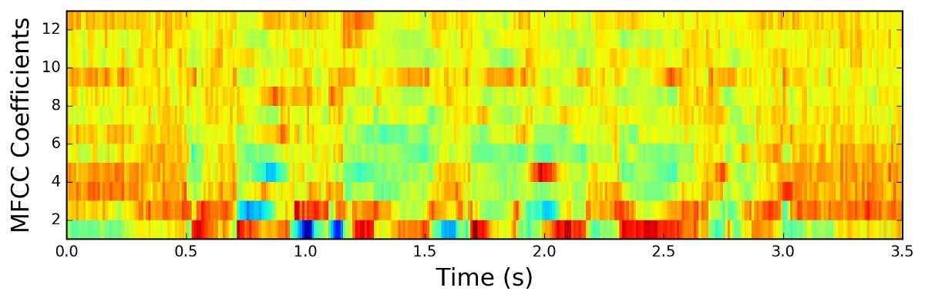
Mel-frequency cepstrum coefficients
Humans do not hear sound linearly, the perceived pitch difference between 55 Hz and 110 Hz and, 440 Hz and 880 Hz are pretty similar. In order to compensate for this , we will use Mel scale which defines frequency bands that are evenly distributed in terms of perceived frequencies.
After mel scaling, we will apply a Discrete Cosine transformation to generate real valued coefficients. This provides us with Mel-Frequency cepstrum coefficients (MFCC)

Slide 38
Implementation of MFCCs
We will be using Librosa library which can automatically generate for us the MFCC values for the track.
We shall use the first 15 coefficients; anything present in higher frequencies will have more noise than useful information
For each song, we shall divide the song into more parts. This is done by keeping track of samples per segment. Since each song is of 30 seconds long, we need to decide how many parts as it will have an impact on the vector size

Slide 39
Implementation of MFCCs
When we split the song into 5 segments each of 6 seconds. We will be left with MFCC feature of shape ( 250, 15), here 15 refers to the 15 MFCC coefficient while 250 refers to the number of frames. If we split the song into 10 segments each of 3 seconds then we get shape (125, 15). Less number of frames is compensated with a greater number of song parts.
At this point we shall assume that it is better to have 250 vector size since the song duration is longer thus allowing for better representation. We shall use 250 vec dataset as our main dataset and build models on it. The best models of 250 vec will be trained on 125 vec dataset and the results will be compared to check if our assumption is correct.

Slide 40
Implementation of MFCCs
All the steps from loading the song, splitting it and extracting the MFCC features is done in the Audio_FeatureExtraction_250 and Audio_FeatureExtraction_125 notebook.
We shall consider each coefficient line as a column and each row as a song for the dataset. So, we end up with 15 columns of coefficient features. Each value of the cell is an np array of actual values. This is saved as a csv file.
This ends the extraction of audio features. We will later merge with lyrical/theme features.

Slide 41
Dataset Pre- processing
Phase 2.2 – Theme Features Extraction

Slide 42
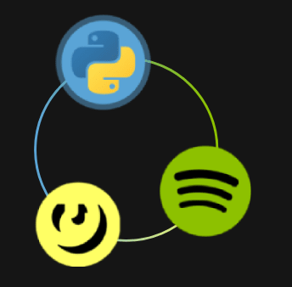
Lyrics Generation
Our ablation experiment required us to supplement audio/MFCC features with theme features (words that capture the theme of a song)
Given that FMA Dataset does not capture a song’s lyrics, we needed to generate the lyrics data for these songs in order to capture the theme features
We decided to use the Genius API to extract lyrics for the songs in our chosen dataset
FMA

Slide 43
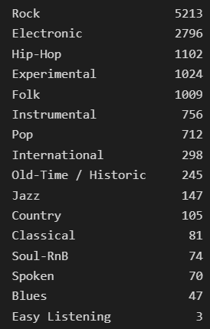
Lyrics Generation
We needed to generate the lyrics for 25k songs using the name of the tracks their artists available in the metadata
Though Genius has a good-sized lyrics repository, we were not able to get the lyrics for all songs
Finally, we were able to generate lyrics for 13,682 songs out of the original 25000 songs in the dataset
The classes in the resultant data we’re imbalanced and would need treatment for the same

Slide 44

Lyrics Language Detection
Another problem that we identified was the presence of languages other than English in the dataset
We needed to determine which songs were English
Towards this end, we utilized pretrained FastText model ‘lid.176.bin’ language identification model
FastText is a library for efficient text classification and representational learning.
Developed at Facebook (now Meta) and open sourced in 2015.
They have several pre-trained English vectors models as well as Multi-lingual word vectors models. We use their pretrained Language Identification model – ‘lid.176.bin’ to identify the language of our lyrics. It has been trained to identify 176 languages

Slide 45
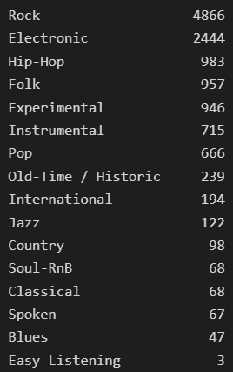
Lyrics Language Detection
We were able to identify languages for all the 13,682 songs
Out of the 13,682 songs 12,843 were identified as English with varying probabilities
The class distribution varied across the English songs (see Figure)
We decided to filter for all English songs for which the language prediction probability was greater than 80%
A total of 10,910 songs were retained

Slide 46
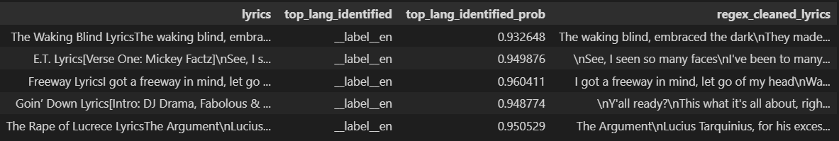
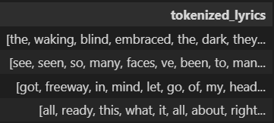
Lyrics Basic Cleaning and Tokenization
We needed to remove unnecessary information in the lyrics which would not help determine the theme
Phrases like ‘[Chorus]’ , ‘[Verse x]’, ‘[Intro x]’ were removed using regular expressions
The resultant lyrics were then tokenized for the purpose of Word2Vec dictionary creation

Slide 47
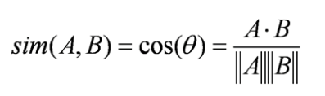

Theme Extraction – Word Embedding
Now that we have the cleaned lyrics for all English songs, we need to extract the theme features for each song
Given that the lyrics data is still in text format, we need to convert it into a format that the algorithm can make sense of the way humans do
Word embeddings help in that process
Words in natural text are converted into a numerical vector which represents the word
They try to capture characteristics which gives context of a word in a text and the semantic and syntactic similarity, relationship with other words
Mathematically, the cosine similarity between similar vectors (words) should be closer to 1
Fig – Intuitively plotting word embeddings would ensure that words with similar/closer meaning are close

Slide 48
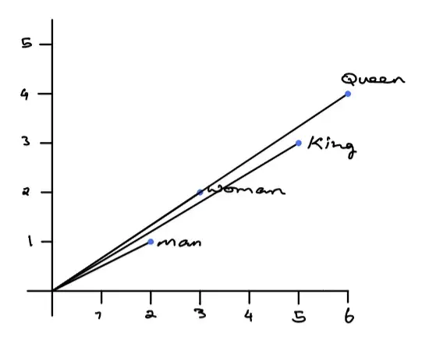
Theme Extraction – Word2Vec
Word2Vec was developed by Tomas Mikolov at Google in 2013 and is a very popular technique in Natural Language Processing for generating word embeddings
It is very efficient in grouping similar words closer in a vector space when given a large enough text dataset and estimating their meaning based on their placement in the text
A simplified example of its capability would be that the word embeddings of – “King”, “Queen”, “Man”, “Woman” , would capture their relationship with each other (see figure)
It achieves this using two methods involving Neural Networks – Continuous Bag of Words (CBOW) and Skip-Gram models
Fig – Here Word2Vec embeddings can capture the relationship –
King – Man + Woman = Queen
[5,3] – [2,1] + [3,2] = [6,4]
Source - https://towardsdatascience.com/word2vec-explained-49c52b4ccb71

Slide 49
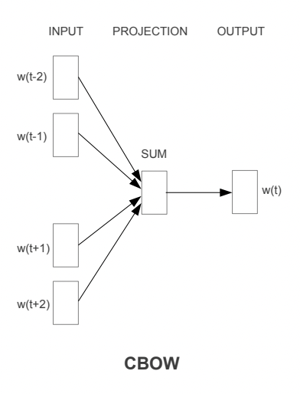
Theme Extraction – Continuous Bag of Words (CBOW)
We used Word2Vec’s CBOW model to generate word embeddings for lyrics
Word2Vec uses shallow neural networks to learn word embeddings in a CBOW model
It tries to predict a target word using context words (words before and after the target word)
It takes one-hot encodings of the context words as the input and tries to predict the one-hot encoding of the target word
It measures the output error and learns the word embeddings by this process
Skip-gram model also uses a shallow neural network which uses a target word to predict probability of the context words
Source - Efficient Estimation of Word Representation in Vector Space

Slide 50
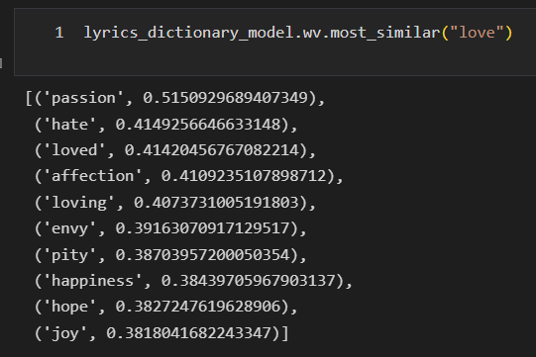
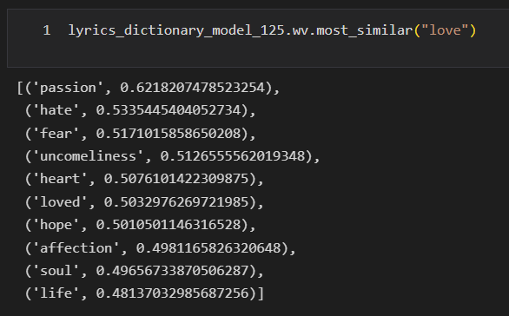
Theme Extraction – Continuous Bag of Words (CBOW)
We created two CBOW models of 250 and 125 vector dimensions to use with the 250 vectors and 125 vectors audio features data respectively
Fig – Words similar to “love” in 250 dimensions (LEFT) and 125 dimensions (RIGHT) Word2Vec model’s vocabulary and their similarity score

Slide 51
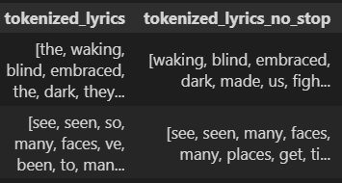
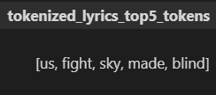
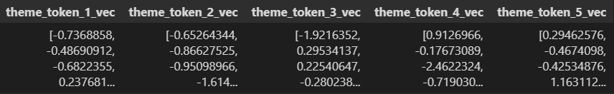
Theme Extraction – Determine the theme vectors
After creating the Word2Vec models, we needed to determine the theme words from songs lyrics
We used our own algorithm for this
We removed stop words (words like ‘a’, ‘the’ etc) using NLTK’s stopwords module from each lyric
From the resultant list of tokens, we took the 5 most repeating tokens
We used the CBOW model’s word embeddings for these 5 tokens as our theme features
This process was repeated for both 250 dim and 125 dim data
The theme features can now be combined with audio features

Slide 52
DATASET PRE-PROCESSING
Phase 3 – Final Dataset Creation

Slide 53
Merging of two features
At this point, we have two CSV files, one with audio features and one with theme/lyrical features.
We remove extra columns and duplicate the theme features to be the same number of audio features with respect to the split.
We finally merge both datasets and check the genre counts. While it was mostly balanced, Rock and Electronic were too high, so we cut them by half
The final dataset contains both audio and theme features. For pure audio models, we drop lyrical features
The entire process flow has been visualized in the next slide.

Slide 54
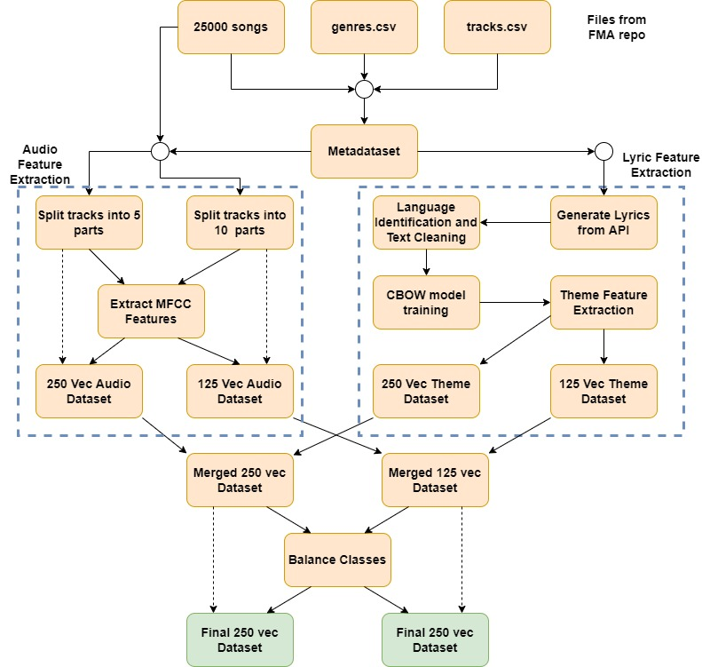

Slide 55
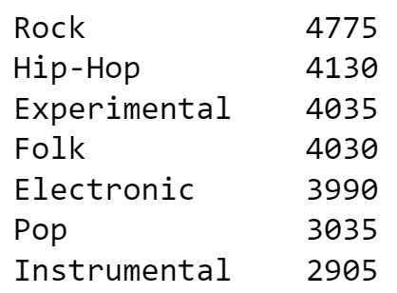
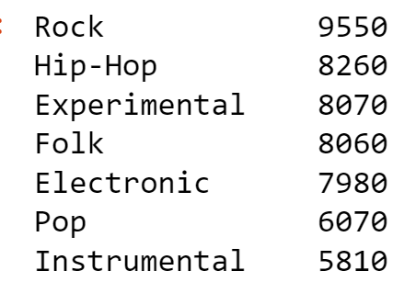
Final Dataset Specifications
250 Vec Dataset
Total songs – 26900
Genre counts
125 Vec Dataset
Total songs – 53800
Genre counts

Slide 56
Models
Part 0 – Precursor Experiments

Slide 57
Precursor experiments
Before creating parallel neural networks or split neural networks, we tried working on single neural networks which had only one input.
The audio features and lyrical features were concatenated and fed to the network. The network performed very poorly compared to the later split neural networks.
The main reason according to us for the poor performance is that models treated both types of features as the same thus making it more difficult to learn. In split neural networks, there is an isolation in the beginning thus driving a more effective training
For ML baseline, we tried logistic regression. Model found it very difficult to converge due to high dimension of data

Slide 58
Common data preparation for models
The data was split in the following ratio for model building
Train – 80% ; Test – 10% ; Valid – 10%
We trained and tested on Train and Test dataset respectively, we then evaluated on Valid dataset to simulate real life.
The target variable was One-hot encoded for all Neural Network models
When training a split neural network, the audio split would comprise of 15 features (MFCC features) and the theme split would comprise of 5 features (theme features)
For training an audio features only network, we only retained the 15 MFCC features

Slide 59
Models
Part 1 – k Nearest Neighbors (kNN)
Establishing a baseline for classical ML techniques

Slide 60
k Nearest Neighbors (kNN)
We wanted to test classical machine learning algorithms as a possible solution for the problem of genre detection before moving into the Neural Networks domain
We used k Nearest Neighbors (kNN) Algorithm for this purpose
Its simplicity being the major reason behind choosing it
The high dimensionality of the data was a big concern when determining the model
We used kNN for classification, but it can also be used for regression problems in machine learning

Slide 61
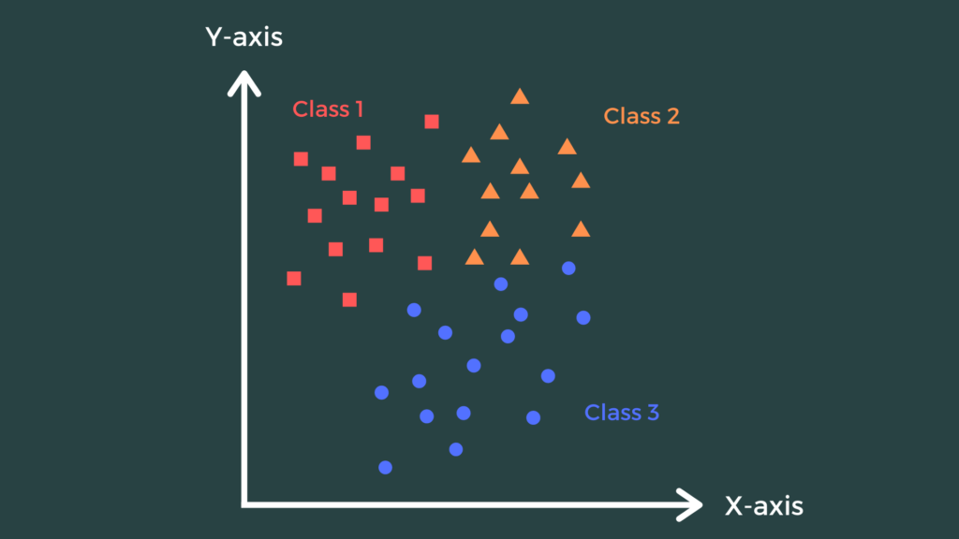
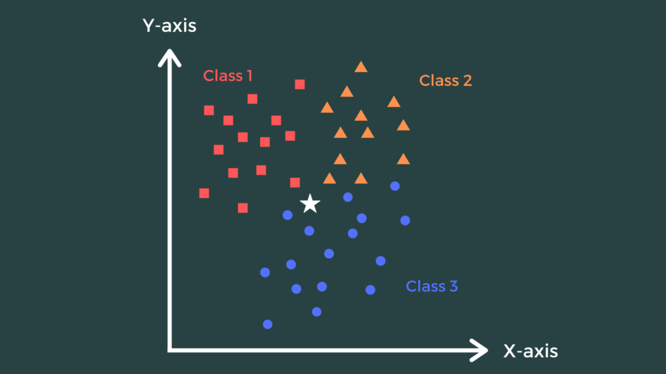
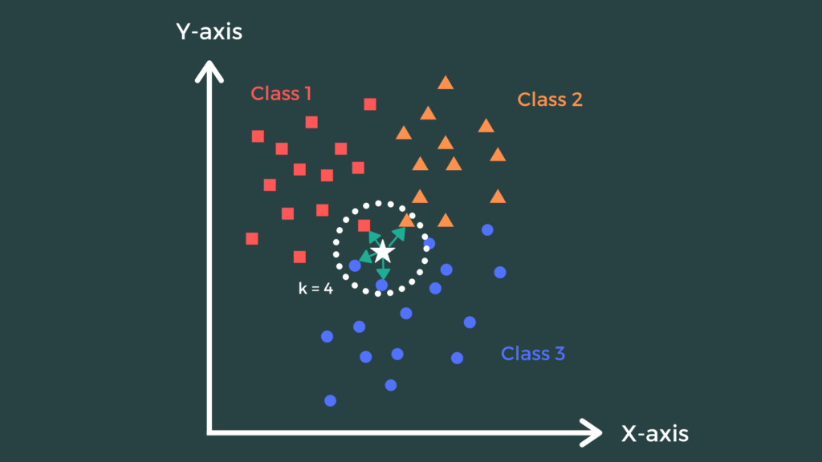
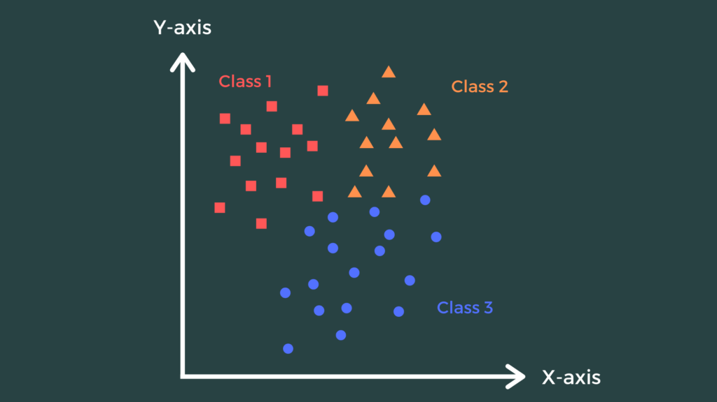
kNN Classification
The algorithm uses the training data and plots each training sample in a n-dimensional space where n is the dimension of the training example (Fig 1)
To predict the class of the new data
It plots the new data in the same spatial domain (Fig 2)
It then finds the k nearest points to the new data and their classes where k is determined by the user (Fig 3)
It then uses this information and does a vote count for each class in its neighborhood (Fig 3)
It assigns the most popular class in its neighborhood to the new data (Fig 4)
Fig 1
Fig 2
Fig 3
Fig 4

Slide 62
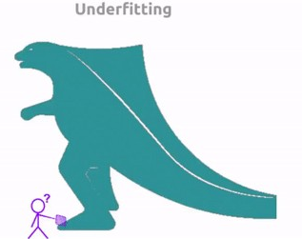
kNN Classification on 250 vec data
We built two kNN models to reflect our ablation experiments
The first model used only the audio features in the training data to predict the genre of new songs in the testing and validation data
The second model used both the audio features and the theme features together to predict the genre for the new songs
The performance for both models was similar and it was poor at predicting the genres for both the old data (training data) and the new data (testing and validation data)
It shows that the model was underfitting by not able to pick up the underlying patterns
DATA
MODEL

Slide 63
kNN - Final Results
 | Train Accuracy (%) | Test Accuracy (%) | Valid Accuracy (%)
Audio + Lyric | 45.22 | 31.37 | 33.01
Audio | 45.12 | 31.30 | 32.75

Slide 64
Models
Part 2 – Deep Neural Networks (DNN)
Exploring the Neural Network domain, starting with DNNs

Slide 65
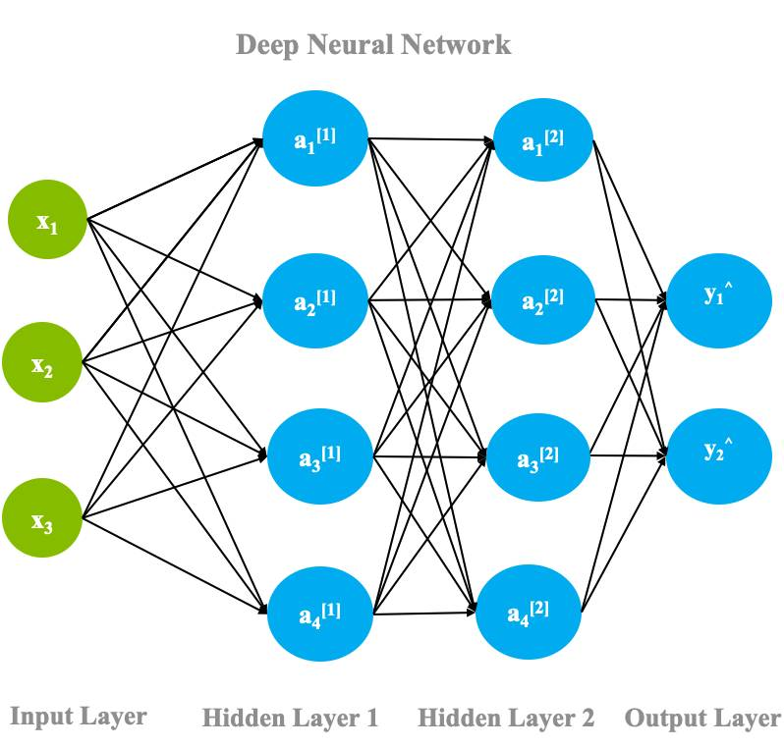
Deep Neural Networks (DNNs)
Neural Networks are the foundation of Deep Learning based on the neurological structure of the human brain
DNNs are complex structures made of artificial neurons that take in multiple inputs to give an output
A basic DNN architecture consists of an input and output layer with one or more hidden layers in between.
The neurons in each layer are connected to the neurons in the succeeding layer with varying weights
In a DNN happens the info flows in a Feed Forward mechanism i.e. from input layer to output layer
This is followed by Backpropagation where after each forward pass, a backward pass takes place while adjusting the weights and biases (model parameters) in order to minimize the output error

Slide 66
Feed Forward Mechanism in DNNs
Here the information from layer flows to the next one
It takes the values in the layer represented by vector x as the input and tries to determine the values of output vector h
x is multiplied with the weight matrix W (the connections between the neurons of both layers) to get vector z
An activation function σ is applied on vector z in the previous step to get vector h
An activation function is a non-linear function mapping z to h
ReLu, Tanh, Softmax are some of the activation functions used
This repeats in each layer until the output layer is reached to give us y_pred values

Slide 67
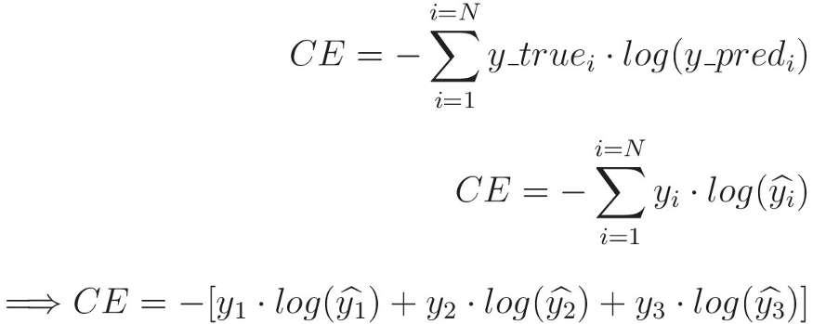
Loss Function
After each forward pass, we use a loss function to calculate the output error based on the actual y and predicted y values
The goal is to minimize this loss to train a robust neural network
Mean Squared Error Loss, Mean Absolute Error Loss and Cross-Entropy Loss are some of the common loss functions
We utilized Categorical Cross-Entropy Loss for training out models
We did this to account the one-hot encoded output layer

Slide 68
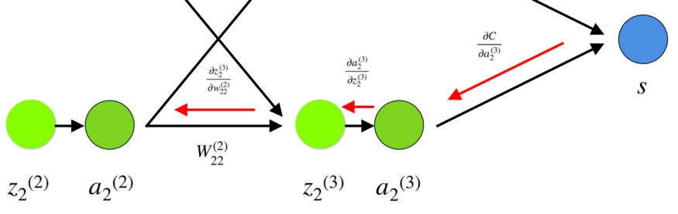
Backpropagation
The minimization of loss function happens using Backpropagation by adjusting the weights and biases (model parameters)
The gradient of the loss function is calculated and determines how the parameters are adjusted
The gradient calculation is done using chain rule to account for the change in each layer’s weights and biases

Slide 69
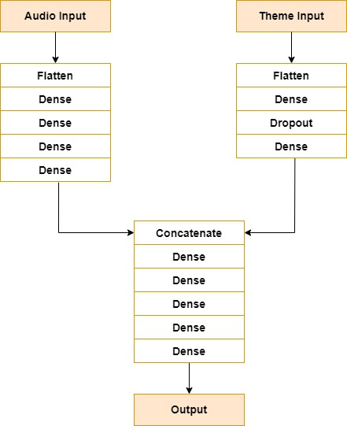
Best DNN architecture for Audio + Theme features

Slide 70
Best DNN architecture for Audio + Theme features
We created a split architecture network with one split each for Audio and Theme features that would get concatenated after some time
We tried simpler architecture with fewer dense layers and got good results with potential for improvement
We iterated over the architecture by changing the placement of flattening layers, increasing network depth by adding dense layers and experiment with regularization
The best architecture
Audio Split – Flatten layer followed by 4 dense layers and no regularization
Theme Split – Flatten layer followed by 2 dense layers with dropout regularization before the 2nd dense layer
Concatenated Split – Concatenation layer followed by 5 dense layers and output layer
Optimizer – Adam Optimizer
Loss Function – Categorical Cross-Entropy Loss

Slide 71
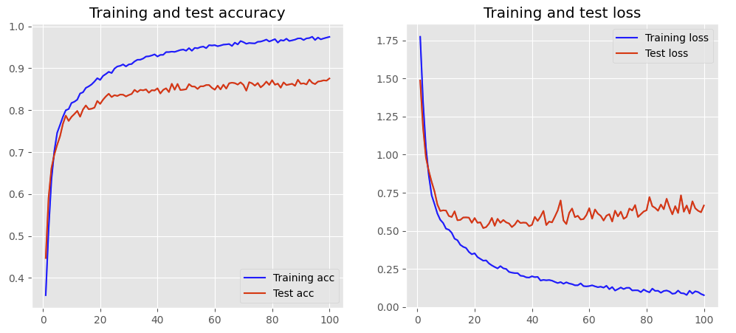
Best DNN architecture for Audio + Theme Graphs

Slide 72
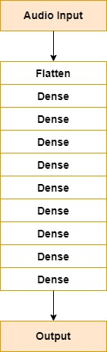
Best DNN architecture for Audio only features

Slide 73
Best DNN architecture for Audio only features
We created a network with greater depth using dense layers and ReLU activation functions
We tried architecture with lesser dense layers but realized more depth was needed
We iterated over the architecture by changing the placement of flattening layers, increasing network depth by adding dense layers
The best architecture
Early flatten after input layer
Followed by 8 dense layers of non-decreasing width feeding into the output layer
Optimizer – Adam Optimizer
Loss Function – Categorical Cross-Entropy Loss

Slide 74
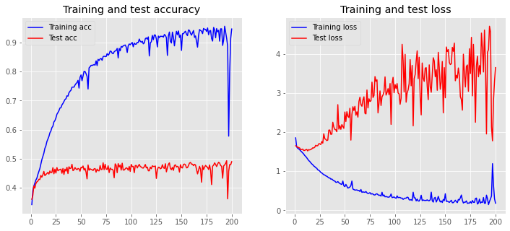
Best DNN architecture for Audio features Graph

Slide 75
DNN - Final Results
 | Train Accuracy (%) | Test Accuracy (%) | Valid Accuracy (%)
Audio + Lyric | 98.65 | 87.55 | 85.80
Audio | 94.63 | 48.96 | 47.69

Slide 76
Models
Part 3 – Convolutional Neural Networks (CNN)

Slide 77
CNN Algorithm
CNN is a specialized neural network that is based on the convolution operator.
It is famous for working well with image classification problems as well as image segmentation and signal processing.
The main intuition behind this algorithm is translation invariance and locality.
Translation invariance refers to when network behaves the similarly to a patch irrespective of its placement in the image. Locality means that each neuron is mostly affected only by its surrounding neurons. Far away neurons have less to nil effect.

Slide 78
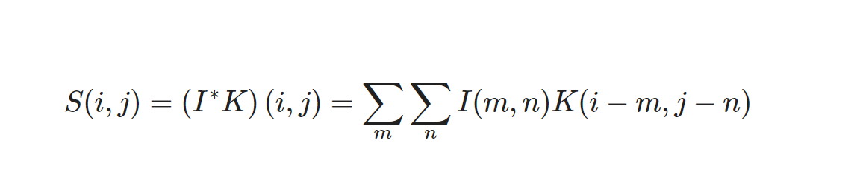
Convolutional operator
This operator is used to transform the image by applying a filter. The filter is smaller than the image and its movement can be controlled using stride. Extra padding can also be used to allow more space for the filter to cover in image.
The following formula represents the operator. Let I be the image and K be the filter/Kernel.

Slide 79
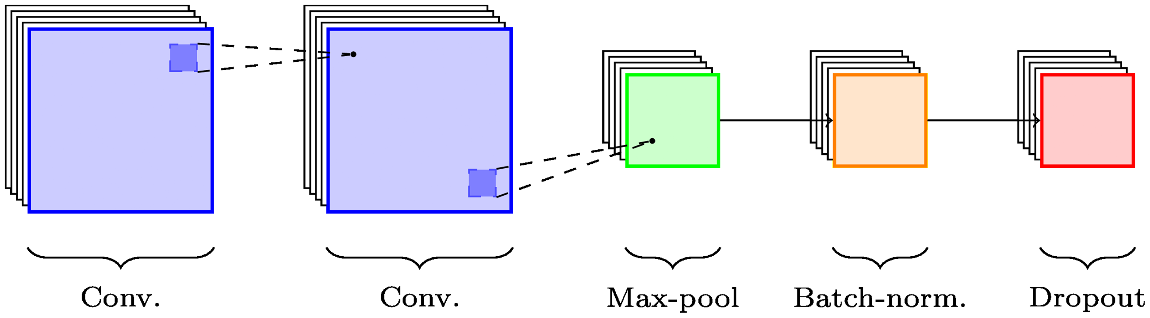

CNN Implementation – Layers
CNN models are implemented using the keras and tensorflow frameworks. Different types of layers have been used each unique in its functionality.
Dense layer – This is the simplest layer used to represent a layer of neurons.
Conv2D layer – This layer creates a convolutional kernel that is convolved with the layer input. We can denote how many filters we need along with their kernel size. We can also choose the padding and stride. By default, it uses VALID padding but for certain layers we have used SAME padding. The activation function used is Relu.
Input

Slide 80
CNN Implementation – Layers
MaxPooling2D layer – This layer is used to apply max pooling operations for 2D spatial data. It down samples the input by taking the maximum value in the window. Different pooling were experimented and not recorded due to a loss in performance.
Batch Normalization Layer – This layer tries to normalize its inputs; this transformation forces the mean output to be close to zero while keeping standard deviation close to one. This helps in handling internal covariate shift and also speeds up training.
Dropout Layer – Applies regularization by turning off certain neurons.
Flatten – This layer is used to flatten the inputs.
Input

Slide 81
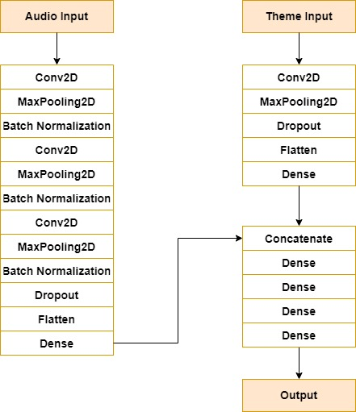
Best model for Audio + Lyrics

Slide 82
Best Audio+ Lyrics Model Architecture
Here for audio input, we create three sets of cov2d + pooling + batch followed by a dropout and flattening. The theme has much shorter having just one set of con2d + pooling with a small amount of dropout
Post concatenation, we have a set of dense layers with mix of Relu and SoftMax activations.
The optimizer is adam with categorical_crossentropy as the loss.

Slide 83
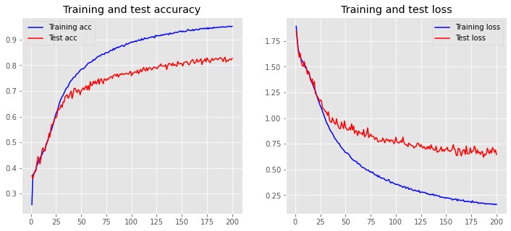
Best Audio+ Lyrics Model Results

Slide 84
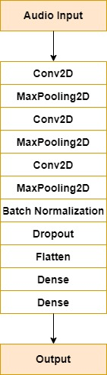
Best Audio only Model

Slide 85
Best Audio only Model Architecture
The single input network contains three sets of conv2d + maxpooling followed by batch normalization and dropout.
Post flattening, we only use 2 dense layers.
Lots of variations of other models were also trained with different regularizations parameters of varying depth and width. Most of them gave similar disappointing results.

Slide 86
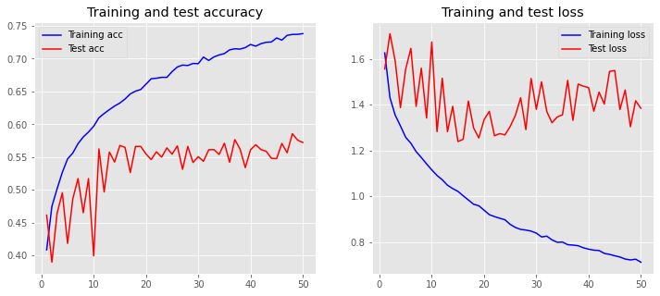
Best Audio only Model Results

Slide 87
CNN - Final Results
 | Train Accuracy (%) | Test Accuracy (%) | Valid Accuracy (%)
Audio + Lyric | 95.20 | 82.71 | 81.63
Audio | 73.82 | 57.21 | 56.06

Slide 88
Models
Part 4 – Recurrent Neural Networks – Long Short-Term Memory (RNN-LSTM)

Slide 89
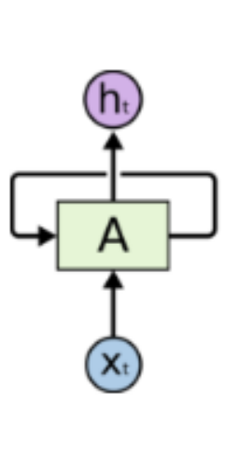
RNN Algorithm
RNN is another specialized neural network, it is more like DNN except that the output of the previous computation is used as the input for the current computation.
After producing the output, it is sent back to the network again where it is stored for further computations.
The biggest disadvantage of this is that very susceptible to vanishing gradients and issues with remembering long sequences.

Slide 90
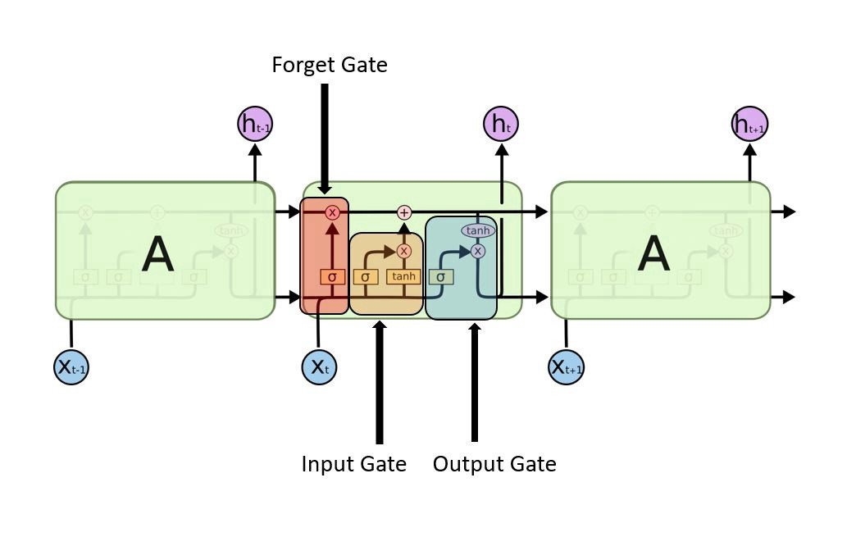
RNN – Long Short Term Memory
One of the ways to combat the disadvantages is to use a Long Short term memory module.

Slide 91
RNN – LSTM
There are mainly three special gates that are present here.
Input Gate – This main job of this gate is to decide which input should be used to modify the memory. Sigmoid function choose the value and tanh function gives the weightage for it.
Forget Gate – This main job of this gate is to decide what needs to be discarded. It uses the previous state and input state to provide a value between 0 to 1. 0 means omit and 1 means keep.
Output Gate – This main job of this gate is to decide what values to let through, similar to input gate , sigmoid chooses and tanh gives weightage.

Slide 92
RNN – LSTM – Layers
Similar to other networks, We used keras and tensorflow to build the models.
The main layer used here is LSTM layer. This layer adds a LSTM layer to our model. The default activation function is tanh and recurrent activation is sigmoid.
One of the most important parameter is ‘return_sequences’. This is used to decide whether the layer should return the last output in the sequence or the full sequence.
Along with our usual regularizers, we also can add regularizer function to the recurrent kernet wrights through ‘recurrent_dropout’ parameter.

Slide 93
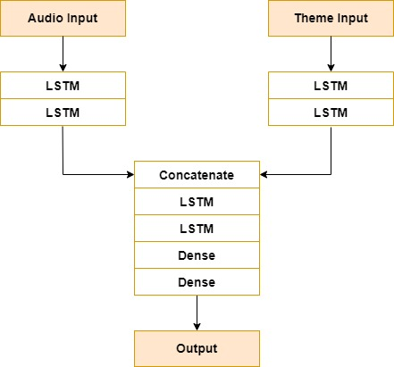
Best Model for Audio + Lyrics

Slide 94
Best Model for Audio + Lyrics
Here we use two LSTM layers for both audio and lyrics, while other models had only dense layers for post concatenation, this one used 2 mode LSTM layers with a mix of dense layers.
Adding regularizer to the layers only resulted in longer train times but no improvement over the results.
The graphs in the next slide show a perfect streamlined increase in accuracy and drop in loss.

Slide 95
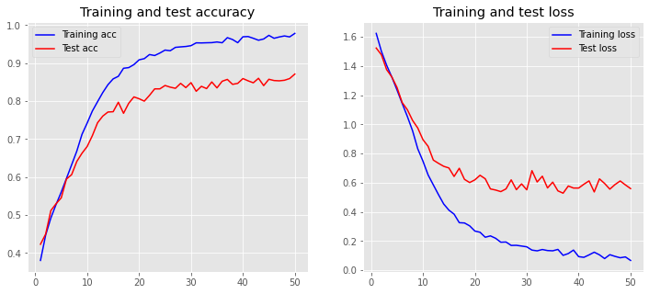
Best Model for Audio + Lyrics Graphs

Slide 96
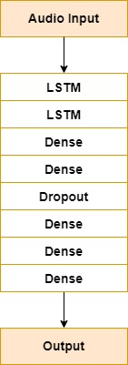
Best Model for Audio only

Slide 97
Best Model for Audio only
Here we used a mix of both dense and LSTM layers. Only 2 LSTM layers have been used with around 5 dense layers.
We played a lot more with width compared to other models, a small dropout regularization has also been added.
The training is done over six sets, totaling 240 epoch
First 50 epoch shows that there is still some more space for the network to learn, so we train the remaining epoch and stop before it tries to overfit. We present only 1st 50 epoch and last 30 epoch.

Slide 98
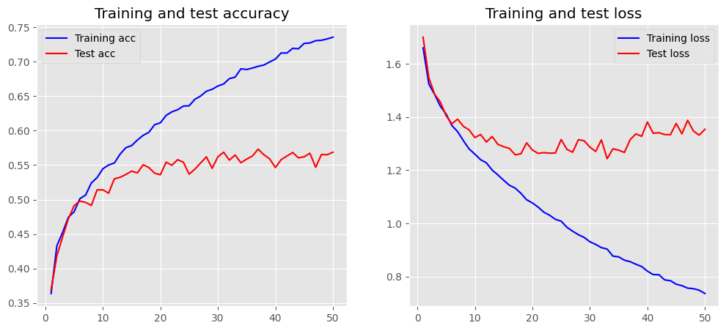
Best Model for Audio only Graphs
First 50 epochs

Slide 99
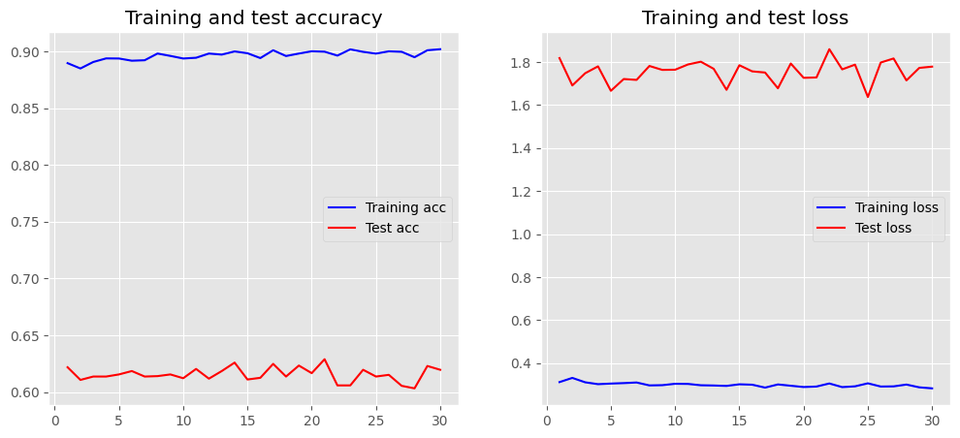
Best Model for Audio only Graphs
Last 30 epochs

Slide 100
RNN (LSTM) - Final Results
 | Train Accuracy (%) | Test Accuracy (%) | Valid Accuracy (%)
Audio + Lyric | 97.84 | 87.14 | 85.39
Audio | 89.03 | 61.97 | 62.01

Slide 101
Models
Part 5 – Recurrent Neural Networks – Gated Recurrent Units (RNN-GRU)

Slide 102
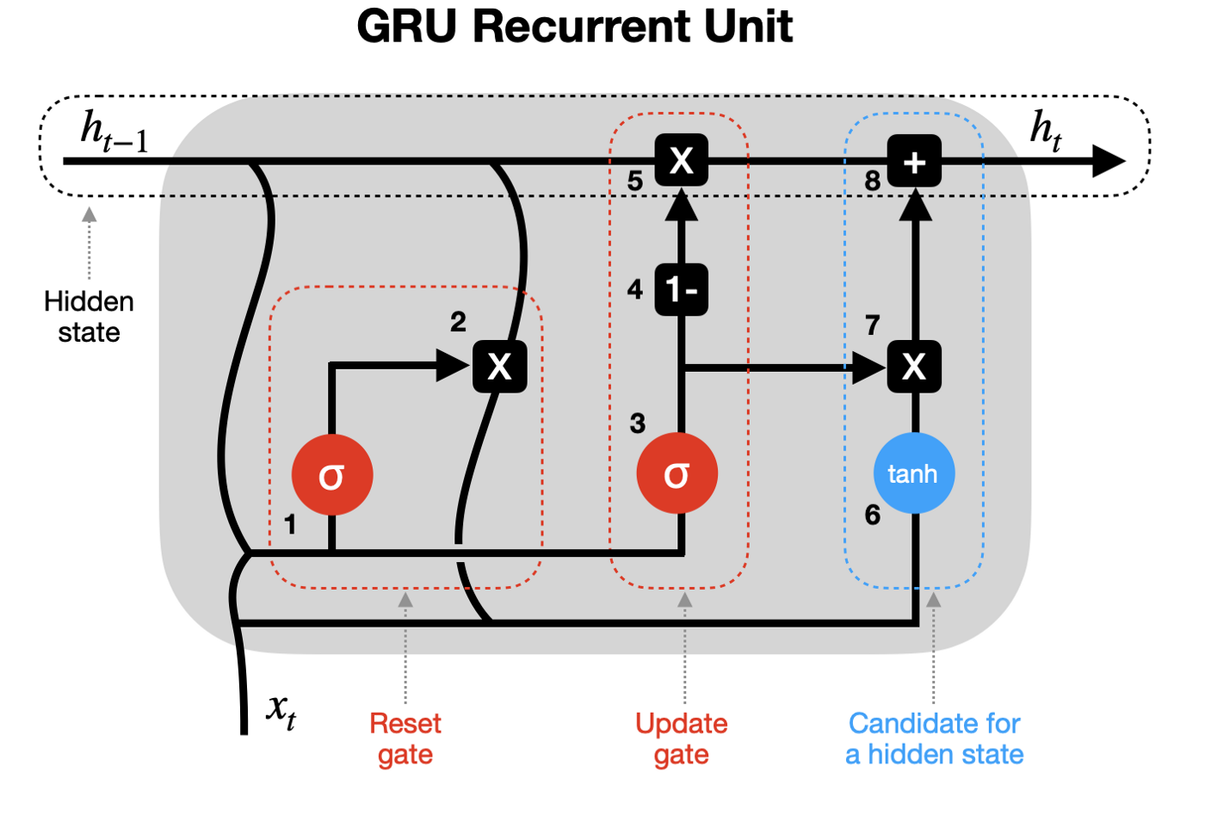
RNN - GRU
The Gated Recurrent unit is another type of RNN which is very similar to LSTM.
GRU mainly tries to rely on its hidden state to transfer memory between the recurrent units thus foregoing the need for separate cell state.

Slide 103
RNN GRU – Gates and Layers
Reset gate – Here, previous hidden state and current state are combined and passed. The gate then chooses to discard , remember or partially retain the data.
Update Gate – This gate updates the hidden state with new information.
Candidate – This is same as hidden state in traditional RNN which has the activation.
The biggest advantage of GRU over LSTM is that it uses less memory and is much faster. The tradeoff is that LSTM can remember longer sequences.
GRU layer – Keras library provided us with this framework. This layer acts very similar to LSTM layer providing similar parameters such ‘return_sequences’ and recurrent dropout.
It also defaults to tanh activation and sigmoid recurrent activation.

Slide 104
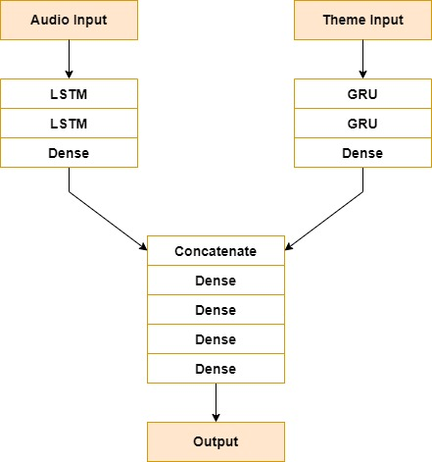
Best Model for Audio + Lyric

Slide 105
Best Model for Audio + Lyric
Pure GRU models gave pretty similar results to LSTM, However the best model comes by combining both LSTM layers and GRU layers
For Audio, we used LSTM layers while lyric or theme used two GRU layers. Post concatenation were just dense layers.
The graphs show a natural ascent in accuracy and descent in loss.
One of things we noticed was regularization affected GRU more than LSTM. We are not sure if this occurrence is specific to our dataset or to the algorithm

Slide 106
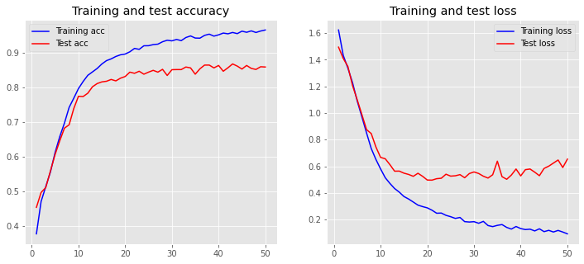
Best Model for Audio + Lyric Graph

Slide 107
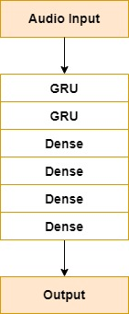
Best Model for Audio only

Slide 108
Best Model for Audio only
The best model contains only 2 GRU layers and 4 dense layers.
While the graphs do suggest that more training could be done, since train accuracy had not reached the limit. By seeing trends in all other algorithms, we will shall assume that test accuracy continues to plateau.
This plateauing suggest that audio is not enough for the model to learn to predict well.

Slide 109
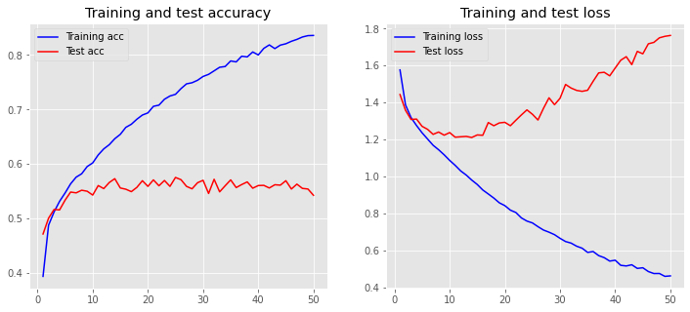
Best Model for Audio only Graph

Slide 110
RNN (GRU) - Final Results
 | Train Accuracy (%) | Test Accuracy (%) | Valid Accuracy (%)
Audio + Lyric | 96.66 | 85.95 | 84.94
Audio | 83.59 | 54.28 | 56.36

Slide 111
Models
Part 6 – Hybrid Models (CNN + RNN)

Slide 112
Hybrid algorithms
While previously, we worked with singular algorithms, we decided to mix two different algorithms in our split network.
Each audio and lyric network will use different algorithms to learn while post concatenation is a simple DNN layers.
Two models were tried under this, one with LSTM for audio and CNN for Lyric while the other used CNN for audio and GRU for Lyric.
The best model was the combination of CNN and GRU. It only outperformed the other slightly.

Slide 113

Best Model

Slide 114
Best Model
We three sets of Con2d,pooling and batch normalization for audio layer before flattening. Only two Gru layers were used for theme.
The graphs shows a natural training for increase in accuracy and decrease in loss
Final Results:
 | Train Accuracy (%) | Test Accuracy (%) | Valid Accuracy (%)
Audio + Lyric | 95.98 | 86.88 | 83.19

Slide 115

Best Model Graph

Slide 116
Models
Part 7 – 125 vec datasets models

Slide 117
Models for 125 vec dataset
For this dataset, we chose the top performing model for each algorithm from 250 vec dataset models.
We see that best performance is given to use by RNN model which uses both LSTM and GRU for its layers.
The graph also shows smooth and natural increase for accuracy and decrease for loss.

Slide 118

Best Model Architecture – RNN (LSTM + GRU)

Slide 119

Best Model Graph – RNN (LSTM + GRU)

Slide 120
RNN (LSTM + GRU) - Final Results
 | Train Accuracy (%) | Test Accuracy (%) | Valid Accuracy (%)
Audio + Lyric | 95.99 | 90.84 | 91.34

Slide 121
Experiment results

Slide 122
Table for results
250 Vec Dataset – Audio + Theme Feature models
250 Vec Dataset – Audio Feature only models
Models | Train Accuracy (%) | Test Accuracy (%) | Valid Accuracy (%)
kNN | 45.22 | 31.37 | 33.01
DNN | 98.65 | 87.55 | 85.8
CNN | 95.2 | 82.71 | 81.63
RNN (LSTM) | 97.84 | 87.14 | 85.39
RNN (GRU) | 96.66 | 85.95 | 84.94
Hybrid | 95.98 | 86.88 | 83.19
Models | Train Accuracy (%) | Test Accuracy (%) | Valid Accuracy (%)
kNN | 45.12 | 31.3 | 32.75
DNN | 94.63 | 48.96 | 47.69
CNN | 73.82 | 57.21 | 56.06
RNN (LSTM) | 89.03 | 61.97 | 62.01
RNN (GRU) | 83.59 | 54.28 | 56.36
125 Vec Dataset – Audio + Theme Feature models
Primary experiment - 250 Vec models with Audio + Theme features performed better than comparable Audio feature only models
Secondary experiment – 125 Vec models performed better than 250 Vec models
Models | Train Accuracy (%) | Test Accuracy (%) | Valid Accuracy (%)
DNN | 94.83 | 90.63 | 90.69
CNN | 90.12 | 86.62 | 87.57
RNN (LSTM + GRU) | 95.99 | 90.84 | 91.34
Hybrid (CNN + RNN) | 94.18 | 89.87 | 90.11

Slide 123
Results analysis
When we look at all the data, we can clearly see that lyric/theme features have certainly helped in increasing the metrics.
Overall, the best performance by sheer valid accuracy is DNN which is of 86% for 250 Vec dataset. Not far behind is RNN – LSTM which is 85%. These minor differences can be considered negligible in the grand scheme of things. The differences can also arise due to the randomized nature, so training once more might result in slightly different metrics.
The worst performance is by KNN which is a simple ML model. This is expected as this model will find it difficult to fit for a high dimensional data.

Slide 124
Results analysis - Audio only models
When we consider the models for audio only, we see a clear a downfall in accuracy.
This trend where the model is unable to properly learn the dataset is common for all the algorithms.
We can see high train accuracies but unfortunately the test accuracies tends to plateau. This plateauing shows us that while the model tries to learn, it never learns to generalize well.
This tells us that just audio MFCC features are not enough to predict well. The best model in this case was RNN with 62% valid accuracy.

Slide 125
Results analysis - Audio + Theme models
The trend of test accuracy plateauing does not happen to these models. The loss graphs show a natural descent which lets us know that the models are able to properly learn.
While train accuracy hovers around 96%, we see a relatively more variation in Valid accuracy. One would expect RNN to perform best since the sequence nature of songs would be perfect fit for this architecture, but It was slightly overshadowed by DNN. Again, the difference is negligible. CNN performed relatively worse compared to DNN and RNN.
We had high hopes for hybrid models, perhaps the strengths of RNN and CNN could be combined but unfortunately there was no specific improvement over other pure algorithm models.

Slide 126
Results analysis - LSTM vs GRU
One of things we wanted to compare was the performance of LSTM vs GRU. Judging by the results, we see both performs equally well with LSTM performing slightly higher.
The increase in metrics for LSTM can be attributed to the fact that although LSTM is much slower and requires more memory, it can remember longer sequences.
This results is specific only to our datasets. It is not possible to truly determine that one is better than the other as there will always be specific scenarios or datasets where one outperforms the other.

Slide 127
Results analysis - 125 Vec models
While 125 vec dataset was considered as our secondary dataset, the models have performed much better than 250 vec datasets.
All algorithms see a significant increase in metrics where all except CNN break the 90% barrier. The highest being 91% for RNN model. This model uses both LSTM and GRU for its layers, but DNN and Hybrid models are not far behind at 90%.
The results shows us that perhaps it is better to have a greater number of songs than having longer songs with more data.

Slide 128
Ablation Experiments
In Ablation study, we remove parts of components of a system to measure the impact of these components.
In our project, it comes in the form of Lyrical/Theme features. Removing it, we see a huge drop in performance almost the point where the networks cant learn enough. It is important to pad the MFCC features with extra help for models.
125 vec dataset shows the impact of vector component. Small vector but more tracks has much better impact on the metrics compared to 250 vec.

Slide 129
conclusion

Slide 130
Objective analysis
Post completion of our project, we are proud to say that we have accomplished all our objectives and learnt a lot in the process.
The primary objectives of building DL models for identifying the genre of the music is very much a success. We have shown that is viable to train and build models for accurate and efficient tagging of genres.
Regarding the secondary objectives, We have shown that it is much better to have Audio + Theme data. It makes sense since more features will help the model most of time except for noisy features.

Slide 131
Objective analysis
In the beginning, we took a decision to put most of our effort into 250 vec models. We believed that having more information per song would of more help to the models.
Unfortunately, we were wrong, the results show that it would have been better to have a greater number of songs compared to more information. In retrospect, perhaps the main reason for the increase in performance is that there is a lot more songs and maybe the higher echelon values in the 250 vector are not that useful compared to the first 125 values.

Slide 132
Curiosities and oddities
Some things we noticed while training is that it was always better to have simpler neural networks compared to a more complex network with a lot of sophisticated layers.
Split neural network architecture which takes multiple input shows us the flexibility of DL.

Slide 133
Future Work
Experiment and build more models for 125 vec dataset to see if we can break the 95% barrier.
Use more audio features such as chords, pitch fluctuation patterns to bolster our dataset.
Use more information from lyrical features in a different way to enhance the entire dataset. Perhaps not eliminating most of the words.
Heirarchial Attention Networks (HAN) would a good alternative here.
Build Models to identify all genres and subgenres instead of just primary genres.

Slide 134
References – Citations
[1] Liu, Caifeng, Lin Feng, Guochao Liu, Huibing Wang, and Shenglan Liu. 2021. “Bottom-up Broadcast Neural Network for Music Genre Classification.” Multimedia Tools and Applications 80 (5): 7313–31.
[2] Feng, Lin, Shenlan Liu, and Jianing Yao. 2017. “Music Genre Classification with Paralleling Recurrent Convolutional Neural Network.” arXiv Preprint arXiv:1712.08370.
[3] Dong, Mingwen. 2018. “Convolutional Neural Network Achieves Human-Level Accuracy in Music Genre Classification.” arXiv Preprint arXiv:1802.09697. 10
[4] Hsu, Wei-Han, Bo-Yu Chen, and Yi-Hsuan Yang. 2021. “Deep Learning Based EDM Subgenre Classification Using Mel-Spectrogram and Tempogram Features.” arXiv Preprint arXiv:2110.08862.
[5] Heo, Jungwoo, Hyun-seo Shin, Ju-ho Kim, Chan-yeong Lim, and Ha-Jin Yu. 2022. “Convolution Channel Separation and Frequency Sub-Bands Aggregation for Music Genre Classification.” arXiv Preprint arXiv:2211.01599.

Slide 135
References - Citations
[6] Tsaptsinos, Alexandros. 2017. “Lyrics-Based Music Genre Classification Using a Hierarchical Attention Network.” arXiv Preprint arXiv:1707.04678.
[7] Oramas, Sergio, Oriol Nieto, Francesco Barbieri, and Xavier Serra. 2017. “Multi-Label Music Genre Classification from Audio, Text, and Images Using Deep Features.” arXiv Preprint arXiv:1707.04916.
[8] Medhat, Fady, David Chesmore, and John Robinson. 2017. “Music Genre Classification Using Masked Conditional Neural Networks.” In International Conference on Neural Information Processing, 470–81. Springer.
[9] Liu, Xiaokai, Shihui Song, Menghua Zhang, and Yafan Huang. 2022. “MATT. A MultipleInstance Attention Mechanism for Long-Tail Music Genre Classification.” In 2022 IEEE International Conference on Systems, Man, and Cybernetics (SMC), 782–87. IEEE.

Slide 136
References - Citations
[10] Araújo Lima, Raul de, Rômulo César Costa de Sousa, Hélio Lopes, and Simone Diniz Junqueira Barbosa. 2020. “Brazilian Lyrics-Based Music Genre Classification Using a BLSTM Network.” In International Conference on Artificial Intelligence and Soft Computing, 525–34. Springer.
[11] McKay, Cory, John Ashley Burgoyne, Jason Hockman, Jordan BL Smith, Gabriel Vigliensoni, and Ichiro Fujinaga. 2010. “Evaluating the Genre Classification Performance of Lyrical Features Relative to Audio, Symbolic and Cultural Features.” In ISMIR, 9:213–18. 13.
[12] Mayer, Rudolf, Robert Neumayer, and Andreas Rauber. 2008. “Combination of Audio and Lyrics Features for Genre Classification in Digital Audio Collections.” In Proceedings of the 16th ACM International Conference on Multimedia, 159–68.
[13] Chathuranga, Dhanith, and Lakshman Jayaratne. 2013. “Automatic Music Genre Classification of Audio Signals with Machine Learning Approaches.” GSTF Journal on Computing (JoC) 3 (2): 1–12.

Slide 137
References - Citations
[14] Çoban, Önder, and I¸sıl Karabey. 2017. “Music Genre Classification with Word and Document Vectors.” In 2017 25th Signal Processing and Communications Applications Conference (SIU), 1–4. IEEE.
[15] Dai, Jia, Wenju Liu, Chongjia Ni, Like Dong, and Hong Yang. 2015. “‘Multilingual’ Deep Neural Network for Music Genre Classification.” In Sixteenth Annual Conference of the International Speech Communication Association.
[16] Karunakaran, Nagamanoj, and Arti Arya. 2018. “A Scalable Hybrid Classifier for Music Genre Classification Using Machine Learning Concepts and Spark.” In 2018 International Conference on Intelligent Autonomous Systems (ICoIAS), 128–35. IEEE.
[17] Zhang, Weibin, Wenkang Lei, Xiangmin Xu, and Xiaofeng Xing. 2016. “Improved Music Genre Classification with Convolutional Neural Networks.” In Interspeech, 3304–8.

Slide 138
References - Citations
[18] Defferrard, Michaël, Kirell Benzi, Pierre Vandergheynst, and Xavier Bresson. 2016. “FMA: A Dataset for Music Analysis.” arXiv Preprint arXiv:1612.01840.
[19] Joulin, Armand, Edouard Grave, Piotr Bojanowski, and Tomas Mikolov. 2016. “Bag of Tricks for Efficient Text Classification.” arXiv Preprint arXiv:1607.01759.
[20] Joulin, Armand, Edouard Grave, Piotr Bojanowski, Matthijs Douze, Hérve Jégou, and Tomas Mikolov. 2016. “Fasttext. Zip: Compressing Text Classification Models.” arXiv Preprint arXiv:1612.03651.
[21] Mikolov, Tomas, Kai Chen, Greg Corrado, and Jeffrey Dean. 2013. “Efficient Estimation of Word Representations in Vector Space.” arXiv Preprint arXiv:1301.3781.

Slide 139
References – General resources
Professors Slides
https://keras.io/
https://www.tensorflow.org/api_docs
https://scikit-learn.org/stable/
https://docs.genius.com/#annotations-h2
https://www.deeplearningbook.org/
https://aditi-mittal.medium.com/understanding-rnn-and-lstm-f7cdf6dfc14e
https://towardsdatascience.com/gru-recurrent-neural-networks-a-smart-way-to-predict-sequences-in-python-80864e4fe9f6

Slide 140
References – General resources
https://www.fulcrumgallery.com/LA-Pop/Headphones-Music-Genres_804397.htm
https://www.fulcrumgallery.com/LA-Pop/Headphones-Music-Genres_804397.htm
https://www.researchgate.net/publication/3333877_Musical_Genre_Classification_of_Audio_Signals
https://spotipy.readthedocs.io/en/2.21.0/
https://towardsdatascience.com/creating-word-embeddings-coding-the-word2vec-algorithm-in-python-using-deep-learning-b337d0ba17a8
https://towardsdatascience.com/introduction-to-word-embedding-and-word2vec-652d0c2060fa
https://towardsdatascience.com/word2vec-explained-49c52b4ccb71

Slide 141
References – General resources
https://www.theclickreader.com/k-nearest-neighbours-knn-classifier/
https://blog.jovian.ai/overfitting-vs-underfitting-25db494bba11
https://www.upgrad.com/blog/neural-network-architecture-components-algorithms/
https://towardsdatascience.com/what-is-deep-learning-and-how-does-it-work-2ce44bb692ac
https://neuralthreads.medium.com/categorical-cross-entropy-loss-the-most-important-loss-function-d3792151d05b
https://towardsdatascience.com/understanding-backpropagation-algorithm-7bb3aa2f95fd

